Slide 1
3(a)
explain why firms in monopolistic competition may make abnormal profit in the short-run but not in the long run. [10]

Slide 2
Definitions/concepts
Monopolistic competition: one of the four market structures with the following characteristics: a large number of firms; substantial control over market price; product differentiation; no barriers to entry.
Abnormal profit: positive economic profit, arising when total revenue is greater than total cost
Short run vs long run: whether there are fixed inputs or not

Slide 3
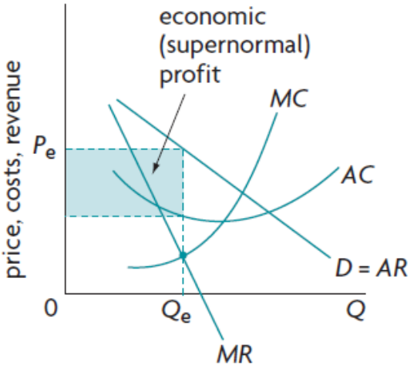
Monopolistic competition diagram
Have some differentiations between products, so demand less elastic than perfect competition, more elastic than monopoly
Profit maximizing: when MR=MC
Profit/loss made: (Pe-AC)*Qe

Slide 4
Key point: no barriers to entry
Short run: inputs are fixed
Long run: nothing is fixed
if profit-making, the abnormal profit attracts new firms to enter –> attract consumers away from the existing firms –> demand curve shift leftwards
If loss-making, some firms shut down –> consumers switch their purchasing to remaining firms –> demand curve shift rightwards

Slide 5
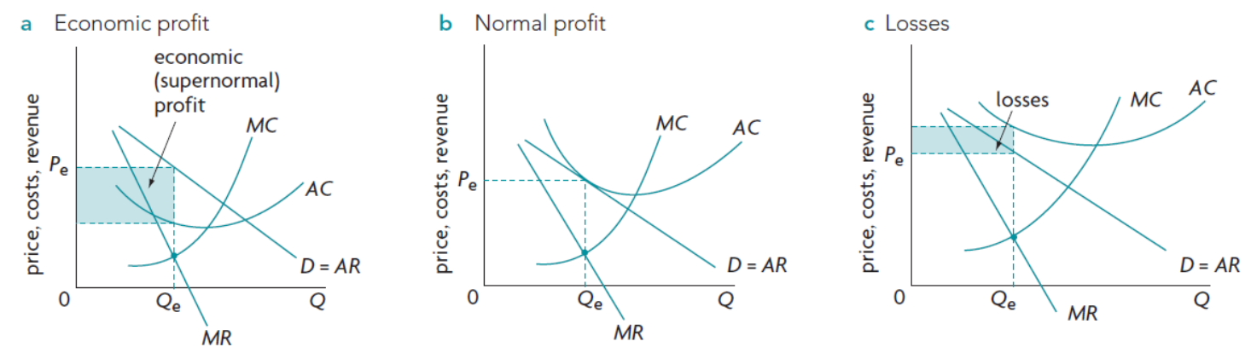
Diagrams for short run and long run

